Slide 1
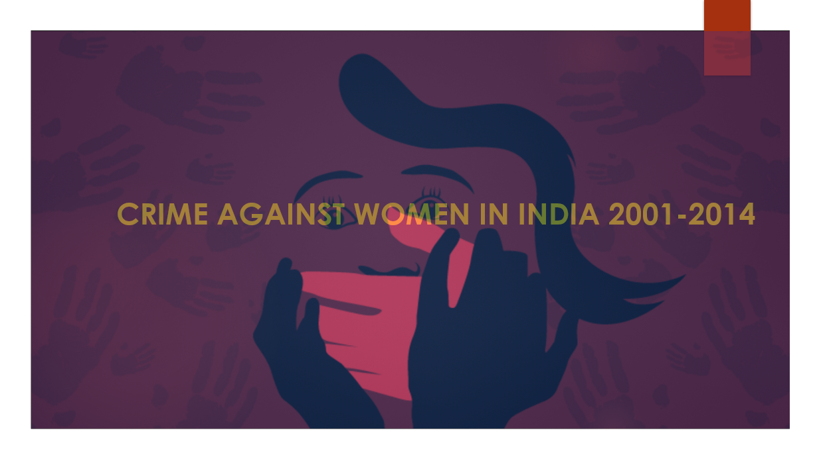
PRESENTED BY SALMANUL FARIZ.M

Slide 2
INTRODUCTION
This data presentation focuses on the alarming statistics related to crimes against women across various states and union territories in India, highlighting trends and patterns from 2001 to 2014
The analysis of crime against women in India reveals critical insights into the safety and security challenges faced by women across various states.

Slide 3
COLUMN DESCRIPTION
STATE: The name of the State or Union Territory in India where the crimes were reported.
DISTRICT: The specific district within the state or union territory where the crime took place.
Year: The year in which the crime incidents were recorded.
Rape: The number of reported cases of rape in that district for the given year.
Kidnapping and Abduction: The number of reported cases of kidnapping and abduction of women.
Dowry Deaths: The number of women who lost their lives due to dowry-related violence.
Assault on Women with Intent to Outrage her Modesty: The number of reported cases of physical assaults against women with the intent to insult or violate their dignity.
Insult to Modesty of Women: The number of cases where women faced verbal or non-physical actions aimed at insulting or harassing their modesty.
Cruelty by Husband or his Relatives: The number of cases involving physical or mental cruelty inflicted on women by their husbands or in-laws.
Importation of Girls: The number of reported cases of girls being trafficked or imported for exploitation.

Slide 4
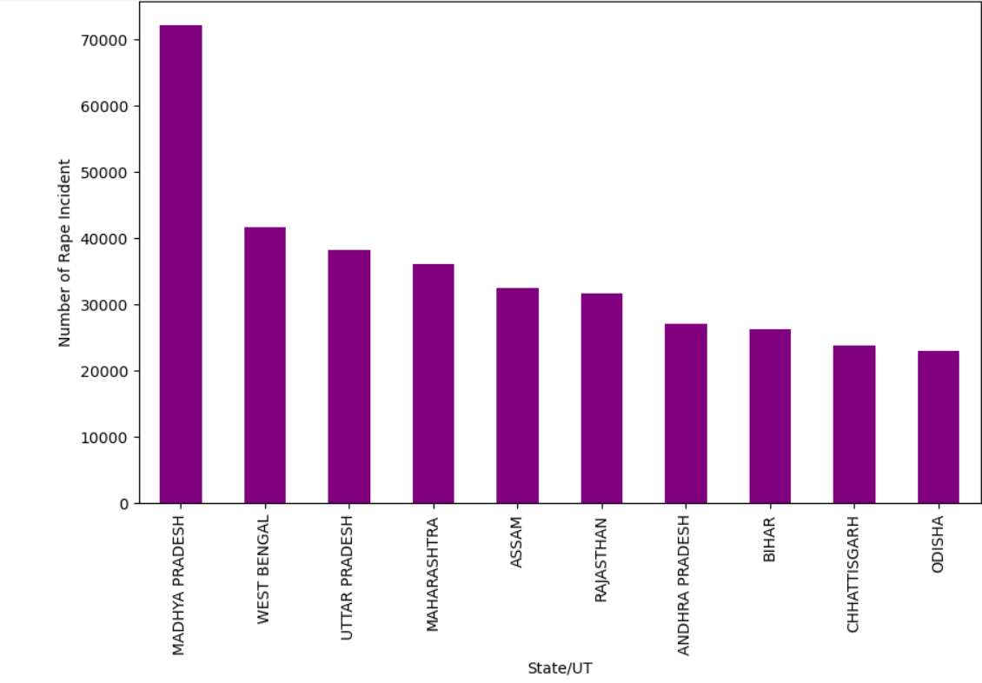
Top 10 States with Highest Rape Incidents
Madhya Pradesh has consistently reported the highest number of rape incidents among all states, raising serious concerns about the safety and security of women in the region

Slide 5
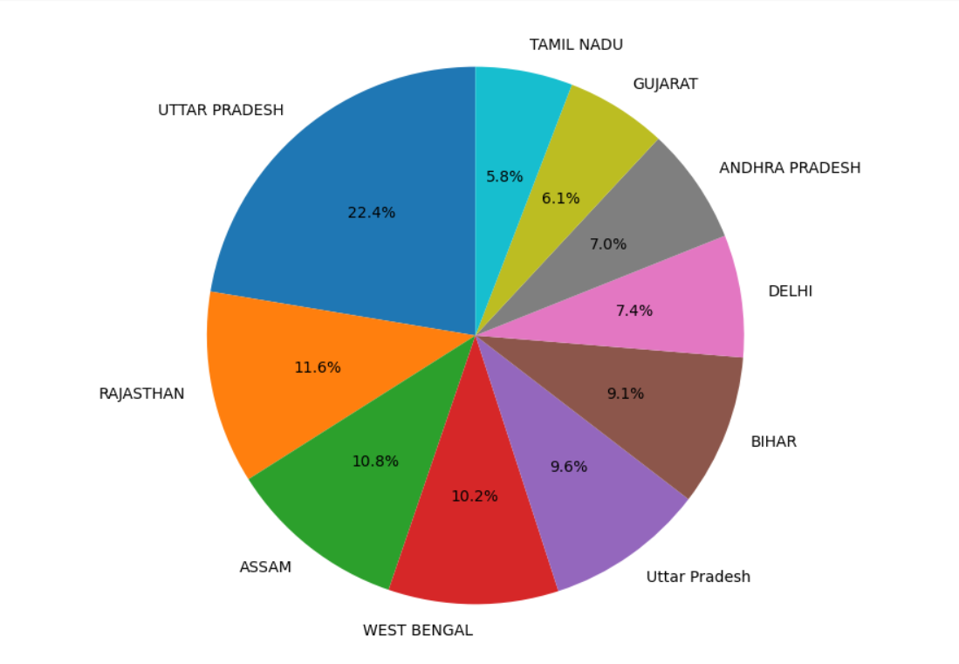
Top 10 States with Highest Kidnapping and Abduction Incidents
Uttar Pradesh has the highest number of kidnapping and abduction incidents in India.

Slide 6
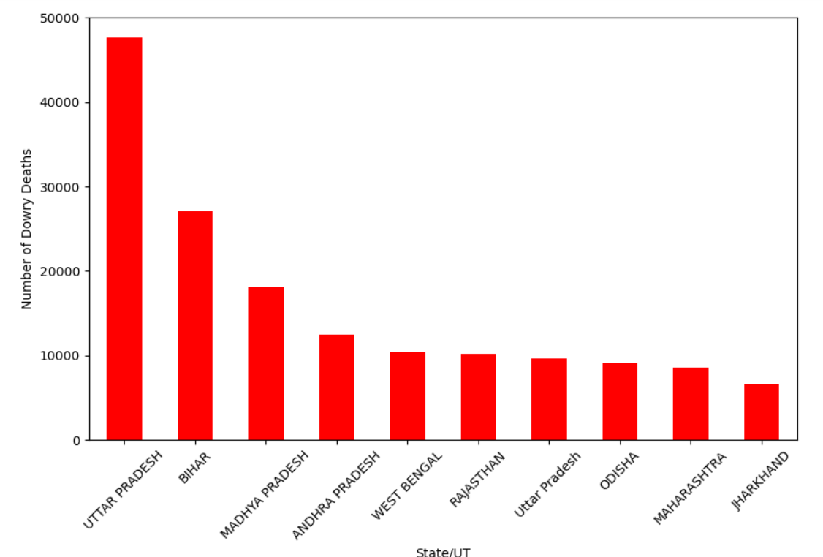
Top 10 States with Highest Dowry Deaths
Uttar Pradesh has the highest number of dowry deaths in India, indicating a serious violation of women's rights and a critical public safety issue that demands immediate attention

Slide 7
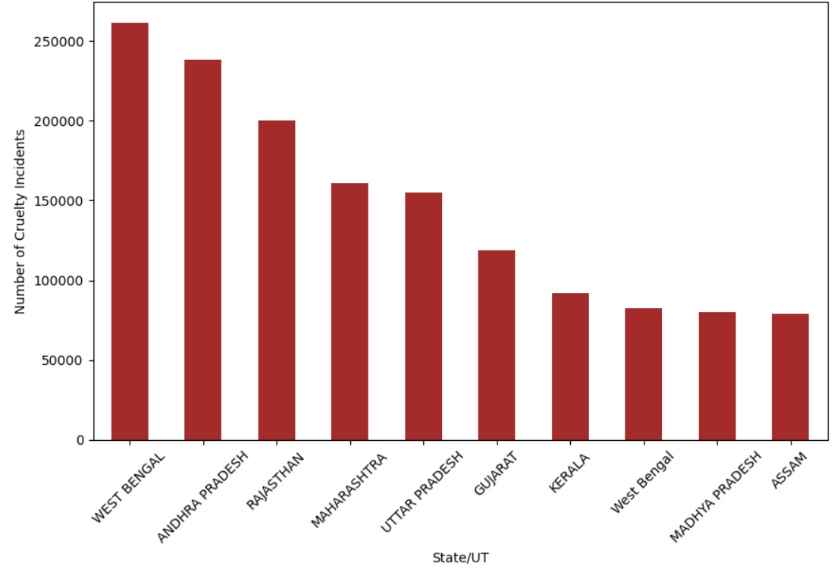
Top 10 States with Cruelty by Husband or Relatives Incidents
West Bengal has the highest number of cruelty incidents by husbands or relatives in India, indicating a pressing concern for women's safety and rights within domestic settings.

Slide 8
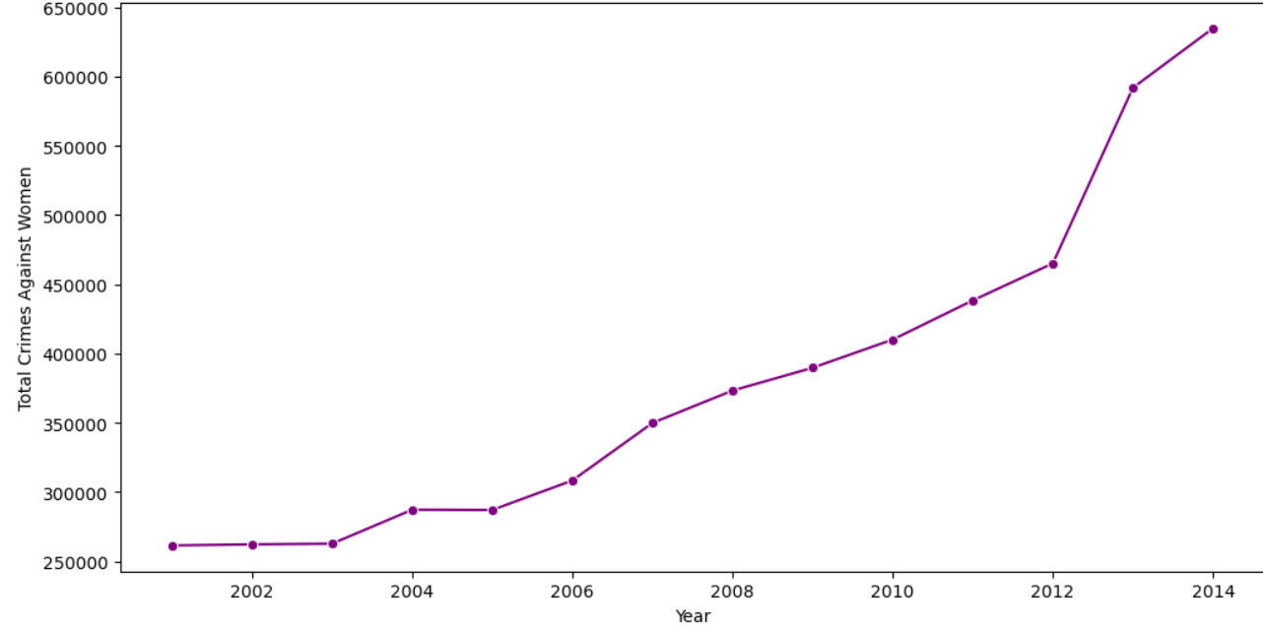
Crime Against Women: Alarming Trends Over the Years
In 2014, the number of reported crimes against women was the highest, raising significant concerns about their safety during that time. This increase emphasizes the need for stronger protective measures and awareness initiatives to ensure women's security. It highlights the importance of addressing these issues to create a safer environment for women in the future.

Slide 9
Steps to Enhance Women's Safety
Strict Law Enforcement: Strengthen and strictly enforce laws against violence and harassment.
Fast-Track Courts: Establish special courts to handle cases of violence against women quickly and efficiently, reducing the backlog of cases.
Helplines and Counseling: Establish dedicated helplines and counseling services to provide immediate support for victims of violence.
Self-Defense Training: Provide free or affordable self-defense classes for women.

Slide 10
THANK YOU

